Slide 1

Hackathon

Slide 2



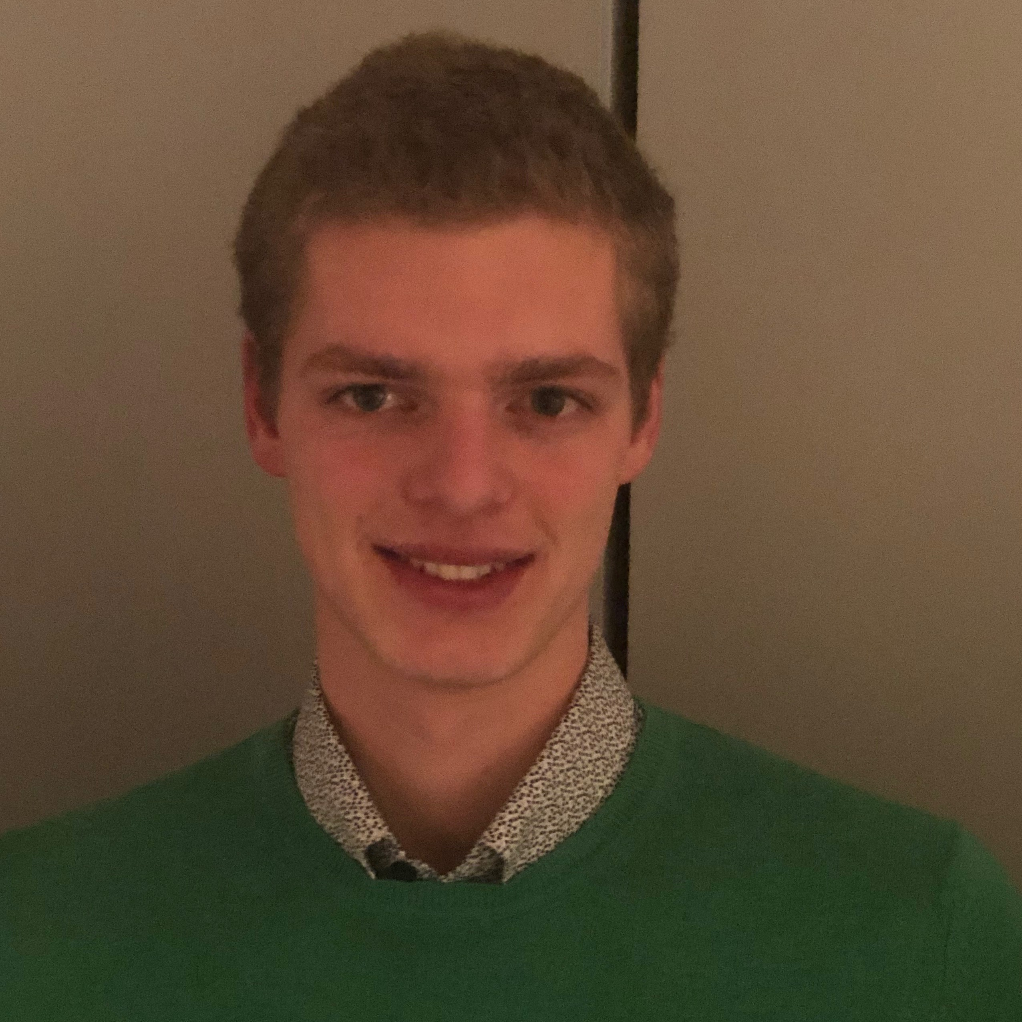


OUR TEAM
Tom
Cyril
Thibault
Antoine
Notes:
Hello
4 first year master students of the Faculty of Applied Science at the University of Liege

Slide 3










THE PROBLEM
…
Notes:
Case that we got : SABAM use case
Every day, the account manager of SABAM looks for new talents to affiliate in Belgium, France and Netherlands
He uses several platforms like Spotify YouTube or Facebook to spot them.
Problem :
Time-consuming
Not funny
When we talk about new musical talents on the net, it’s often to late (they have been reached by other people)
What does SABAM want ? It wants to detect new talents before anyone else does
How could we do that ?

Slide 4

OUR SOLUTION
ML
…
Notes:
Use some machine learning on the exact same plateforms that the employee use every day
Depending on the plateform, these algorithms will look for some signs about new songs that could possibly be a buzz

Slide 5
OUR SOLUTION
ML
…
Spotify
Notes:
For a question of time : focus on Spotify
Why Spotify ? Because they have an amazing Web API that allows us to get extremely precise data about a song such as:
Its tempo
Its energy
Its danceability
…
The idea is to analyze these features for a huge amount of songs and find a correlation between the features of a song and its popularity
How to evaluate the popularity of a song ?
That’s where the Spotify API is very awesome : it provides a feature “popularity” giving a value between 0 and 100 for each song available on Spotify (100 being the maximum of popularity)
This feature is a function of the number of clicks on the song on the platform, but it also decreases over time making the buzz of today more popular than the buzz of 2 years ago

Slide 6
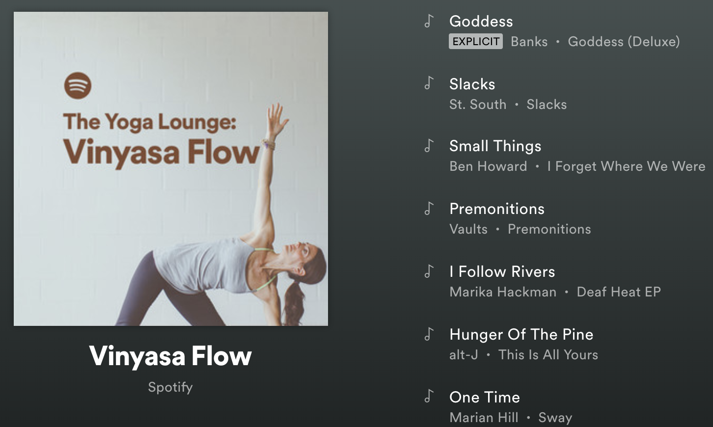









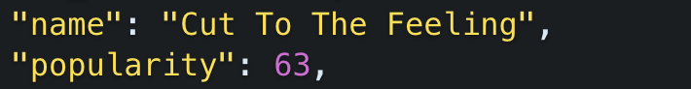
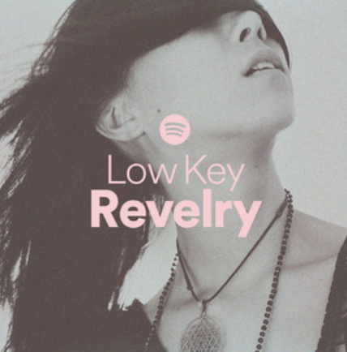
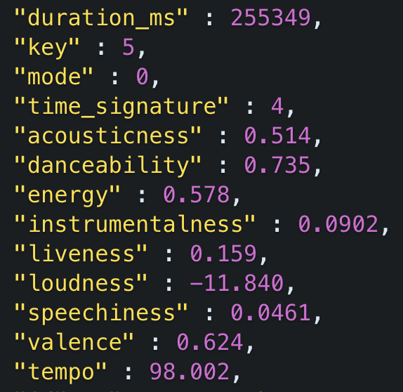
FIRST STEP – COLLECTING DATA
Notes:
What we want : a lot of tracks of all genres to analyze at best the popularity of songs depending to its features.
How do we get the songs ?
Take all kind of playlists made by Spotify going from classic to rock, extract each track of these playlists and get all the features of each track.

Slide 7
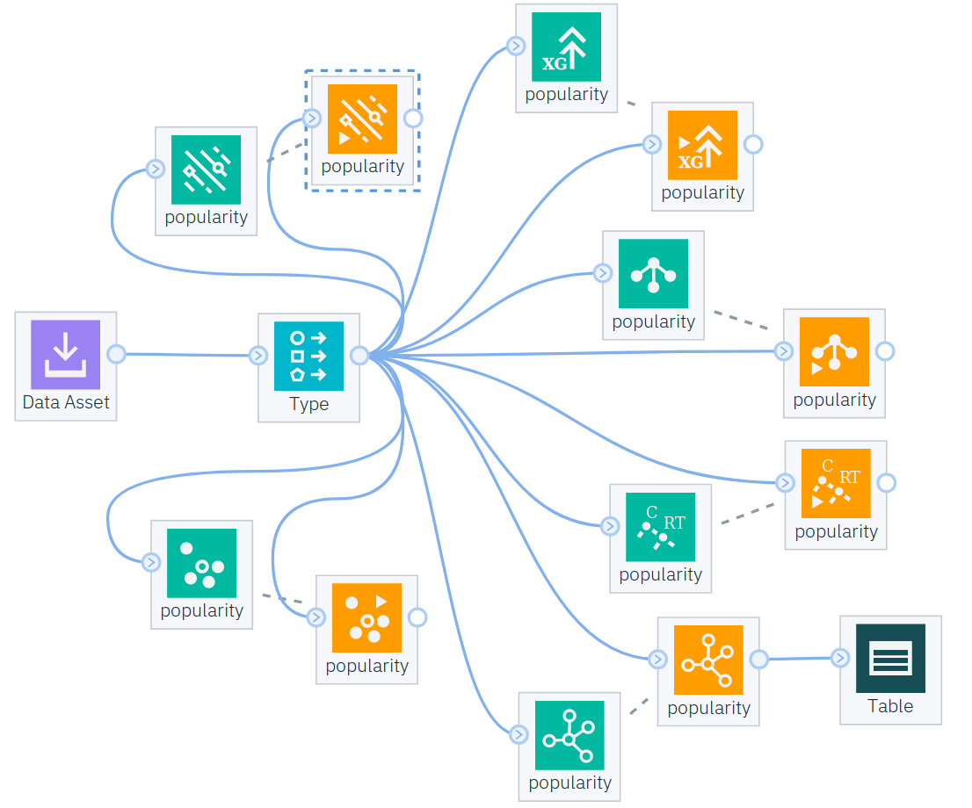

SECOND STEP – TRAINING DATA
Model used | Mean error *
Random Forest | 5,382
XGBoost | 9,304
K-Nearest Neighbors | 11,968
Regression Tree | 13,191
Support Vector Machine | 13,762
Neural Network | 14,1415
* Mean absolute error on the
popularity (0 to 100) of the
testing set.
Notes:
Training step quite easy with Watson Studio
Just tested some learning algorithms we thought would be the best for this problem and output some analysis to check the most precise one.
Obviously this is the random forest model that gives the best results with an average error on the popularity of a song of only 5.4, which is quite good.
And so that’s the one that we decided to keep for our user application.

Slide 8



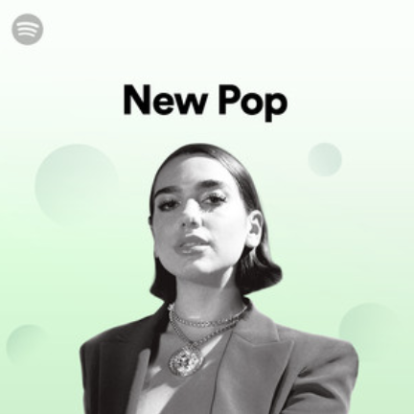

THIRD STEP – PREDICTING BUZZ
Name | Hit | Potential
Damso | CQFD | 76 %
Nicki Minaj | FEFE | 71 %
Angele | Jalousie | 68 %
… | … | …
Name | Hit | Potential
Damso | CQFD | 76 %
Angele | Jalousie | 68 %
… | … | …
Notes:
Once again, the Spotify API give us the possibility to get all the new releases relevant to a particular country.
These tracks were sent as inputs to our REST API developped in Watson, and we were able to to compute and receive their estimated popularity, which actually corresponds to the percentage for that song to be a hit.
Then we need to filter the output artists to only keep Belgian ones.
For that, using the Spotify API is impossible because it does not provide any feature concerning the nationality of an artist.
As a solution, we found another Web API called “music story” that contains a large database of European musicians and that can give us the nationality of an artist given his name.
Unfortunately, we found that API too late and didn’t have enough time to finish the implementation of the filtering.

Slide 9
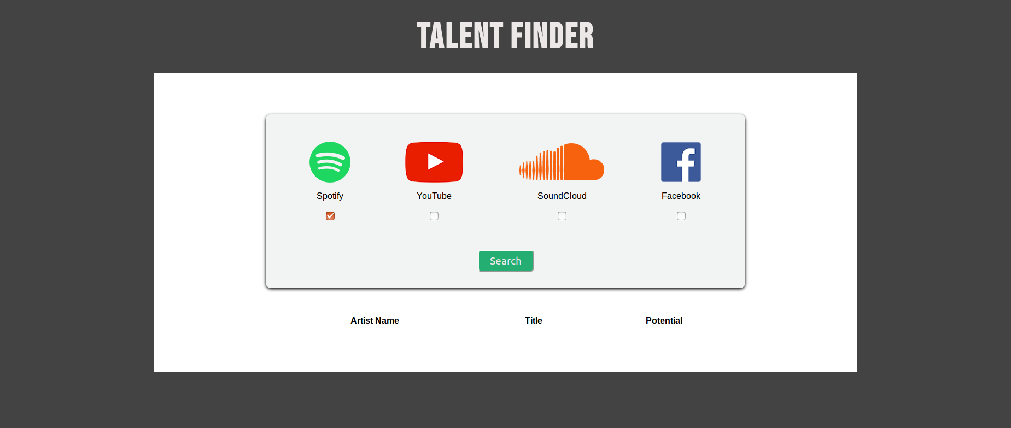
FINAL APPLICATION
Notes:
- Web application with a user-friendly interface for our SABAM employee
The only thing he will have to do arriving at his office the morning will be to select the plateforms in which he wants to search potential talents, click the search button and after a few minutes the application will give him a complete list of new potential talents.
(If time) : demo

